Slide 1
Connecting to Databases
ODBC Primer
Limerick Institute of Technology

Slide 2
Learning outcomes
Learning outcomes – the student will
Be able to describe ODBC purpose and architecture

Slide 3
ODBC – What is it?
ODBC = Open Database Connectivity
Microsoft ‘Standard’ for database connectivity
It is a standard programming interface between applications and Data Sources
Most commercial DBMS conform to ODBC and provide drivers for ODBC interoperation
Advantages – Applications can be developed independently of DBMS
Disadvantages – DBMS vendor specific features cannot be accessed via ODBC

Slide 4
ODBC Architecture
Application1
Application2
4 level architecture
Driver Manager
Driver
Driver
DBMS –
Data
Sources

Slide 5
ODBC Architecture
Application: A program that processes data. The application makes ODBC function calls to interact with data sources.
Driver Manager: DLL that provides access to individual data source drivers. The driver manager loads the driver DLLs and directs function calls to them.
Driver: Is a DLL which sits between the driver manager and the data source and processes ODBC function calls. The driver connects to the data source on command from the application. The driver translates function calls and SQL statements from ODBC standard to data source specific formats.
Data Source: Defined in the system registry – it will contain several parts – the data itself, the DBMS, the platform on which the DBMS is running and possibly the network used to access the platform.
Application1
Application2
Driver Manager
Driver
Driver

Slide 6
ODBC Architecture - Standards
Application1
Application2
Standardised ODBC function calls
Standardised SQL instructions/queries
Driver Manager
ODBC standard to vendor specific translation
Driver
Driver
DBMS specific function calls
DBMS specific SQL instructions/queries

Slide 7
ODBC Architecture (Windows Example)
Application1
Application2
ODBC Administrator
MS Access ODBC Driver
Oracle ODBC Driver
Microsoft DBMS Engine (JET)
ORACLE DBMS
Data
Sources

Slide 8
Example – ODBC setup and programming process
Create an MS Access database (or download an example from moodle)
Register the MS Access DB with ODBC
Write your application program (PHP,C# etc)
Code your application to connect to the DataSource registered in ODBC

Slide 9
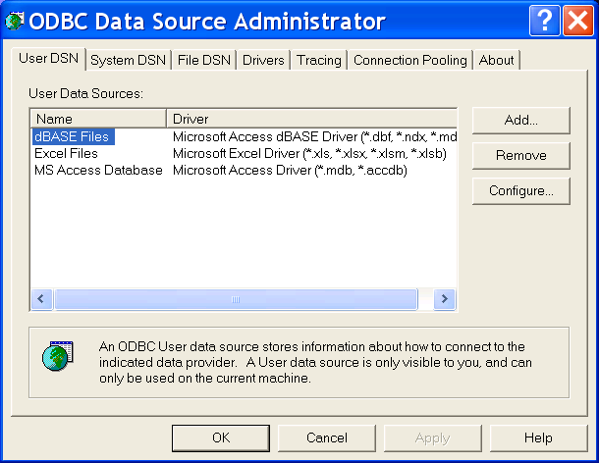
Windows ODBC Data Administrator
The ODBC administrator can normally be found in the Control Panel under Administrative Functions
In 1A14 lab – the ODBC administrator can be found as follows:
C:\Windows\SysWOW64\odbcad32.exe

Slide 10
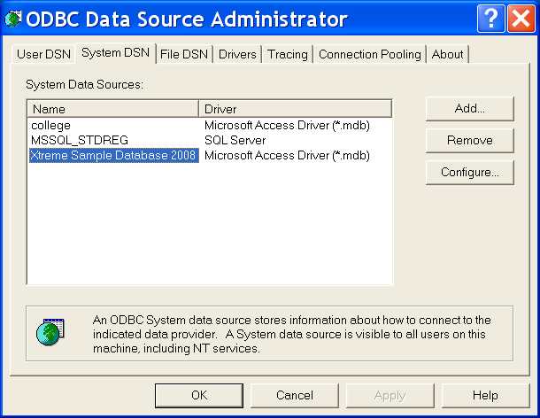
Example - Register a DB
Select the SYSTEM DSN tab
And ADD

Slide 11
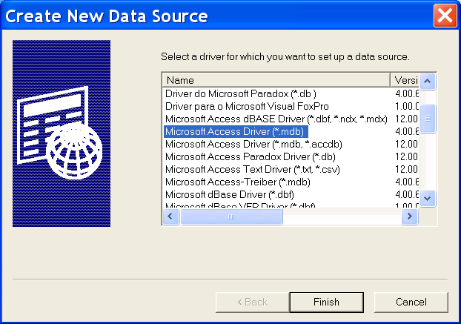
Example - Register a DB
Select an MS Access Driver

Slide 12
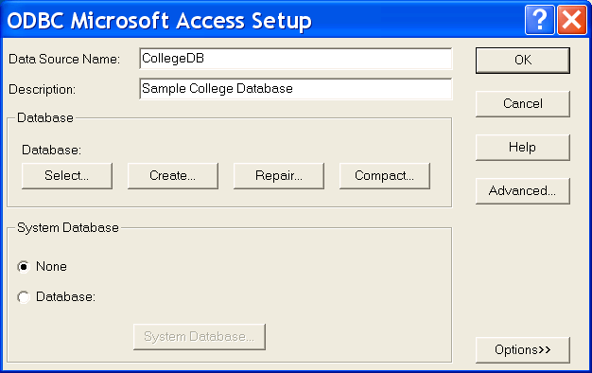
Example - Register a DB
Enter your DSN
And Description
Then hit SELECT

Slide 13
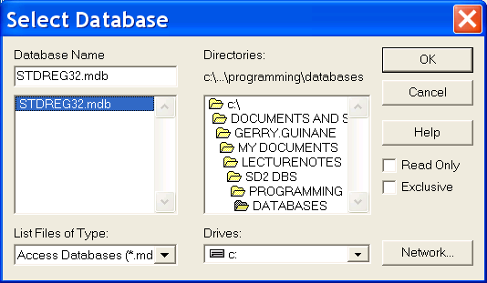
Example - Register a DB
Select the MS Access Database you want to register then click OK

Slide 14
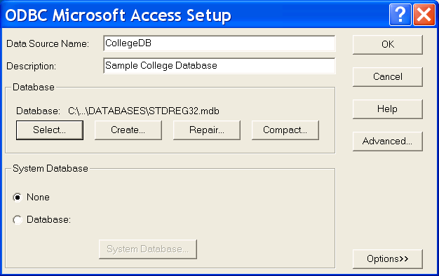
Example - Register a DB
Review, then hit OK

Slide 15
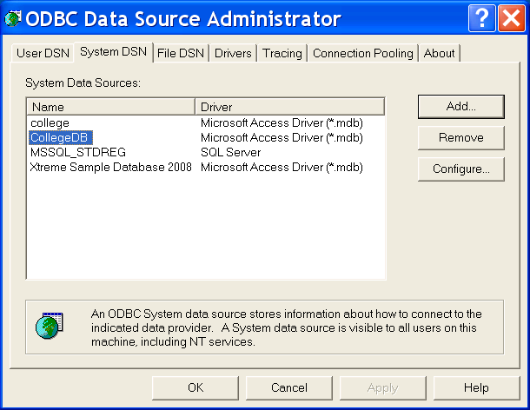
Example - Register a DB
Your DB is now registered
hit OK

Slide 16
ODBC – Industry Support
Database servers
SQL server,oracle, Informix, DB/2, AS/400
Local/file based sources
MS access, dbase, excel

